Slide 1


HOMEWORK
Watch & Answer
NEED TO BE DONE
BEFORE THE CLASS
WATCH
https://www.youtube.com/watch?v=Hej48pi_lOc
ANSWER
Q1 - What are the benefits of using .env file?
Q2 – Why did he used Promise instead of callback functions
Q3 – At some point of the video, he used destructuring assignment. Where and why?

Slide 2


BACK-END DEVELOPMENT COURSE
WEEK 6 – Database Integration

Slide 3

Session objectives
JS Async syntax … Get ready for for database interactions !
Apply destructuring with arrays and objects
Understand Promises and handle .then() / .catch()
Write clean async code using async / await
Understand the need for databases
Differentiate between SQL and NoSQL databases
Review key MySQL queries for data manipulation
Connect a Node to MySQL database
Organize code using clean architecture principles for maintainability

Slide 4
EXPLAIN
Destructuring in JS
SEE MORE
Destructuring is a JS syntax to unpack values from arrays or objects
const [a, b] = [10, 20];
console.log(a); // output: 10
console.log(b); // output: 20
const [c, d, ...rest] = [10, 20, 30, 40, 50];
console.log(rest); // output: Array [30, 40, 50]

Slide 5
QUIZ
What will this code print out ?
const [rows] = [ [1, 2, 3], 4, 5];
console.log(rows);
[1, 2, 3]
1
undefined
[[1, 2, 3], 4, 5]

Slide 6
What will this code print out ?
ANSWER
const [rows] = [ [1, 2, 3], 4, 5];
console.log(rows);
[1, 2, 3]
1
undefined
[[1, 2, 3], 4, 5]

Slide 7
QUIZ
What will this code print out ?
const [head, ...tail] = [1, 2, 3, 4];
console.log(tail);
2
4
[2,3,4]
[1,2,3,4]

Slide 8
What will this code print out ?
ANSWER
const [head, ...tail] = [1, 2, 3, 4];
console.log(tail);
2
4
[2,3,4]
[1,2,3,4]

Slide 9
EXPLAIN
Promises in JS
SEE MORE
A Promise is an object representing the completion or failure of an asynchronous operation
let myPromise = new Promise(function(myResolve, myReject) {
// Do something that takes time…
myResolve(); // when successful
myReject(); // when error
});
myPromise.then(
(value) => { /* code if successful */ },
(error) => { /* code if some error */ }
);
then() takes 2 args:
a callback for success
a callback for failure.

Slide 10
EXPLAIN
Promises with Async
SEE MORE
The keyword async before a function makes the function return a promise
EQUIVALENT
function myFunction() {
return Promise.resolve("Hello");
}
async function myFunction() {
return "Hello";
}
Wrap the return with a Promise<string>
That is resolved
Create a Promise<string>
That is resolved
Both functions return a Promise ! The Promise then() method can used:
myFunction().then(value => console.log(value));

Slide 11

EXPLAIN
Promises with Async, Await
SEE MORE
await is used to pause the execution of an async function until a Promise is resolved
async function getData() {
// Do something that takes time…
return 42.2;
}
returns a Promise<number>
EQUIVALENT CODE
function main() {
getData().then(data => console.log(data));
}
main();
async function main() {
await data = getData();
console.log(data));
}
main();
await syntax works only inside an async function

Slide 12
QUIZ
What does the async keyword do when added to a function?
Makes the function non-blocking
Converts return values into Promises
Allows usage of await inside it

Slide 13
ANSWER
What does the async keyword do when added to a function?
Makes the function non-blocking
Converts return values into Promises
Allows usage of await inside it
ALL !

Slide 14
QUIZ
What will this code print out ?
async function test() {
console.log("A");
const result = await Promise.resolve("B");
console.log(result);
console.log("C");
}
console.log("D");
test();
console.log("E");
A. A B C D E B. D A B C E C. D A E B C D. A D E B C

Slide 15
What will this code print out ?
ANSWER
async function test() {
console.log("A");
const result = await Promise.resolve("B");
console.log(result);
console.log("C");
}
console.log("D");
test();
console.log("E");
A. A B C D E B. D A B C E C. D A E B C D. A D E B C
Synchronous logs: "D", "A", "E“
Then after the microtask (await): "B", "C"

Slide 16
QUIZ
What will this code print out ?
async function one() {
console.log("M");
}
async function two() {
await one();
console.log("N");
}
two();
console.log("O");
A. M → O → N B. M → N → O C. O → M → N D. M → O → N → undefined

Slide 17
What will this code print out ?
ANSWER
async function one() {
console.log("M");
}
async function two() {
await one();
console.log("N");
}
two();
console.log("O");
A. M → O → N B. M → N → O C. O → M → N D. M → O → N → undefined
one() is called immediately from two(), so "M" logs.
await one() pauses two() before "N".
Meanwhile, "O" logs. Then "N" resumes.

Slide 18

WARM UP
What do you know about Databases?
Think – Discuss – And share your outputs
What is a database, and why might we need one in a web application?
(Think beyond just "storing data" — consider retrieval, searching, and data relationships.)
2. What are the benefits of a database over plain files (like JSON or CSV)?
(Consider performance, scalability, consistency, and ease of access.)

Slide 19

Why do we need databases ?
ANSWER
Databases enforce schemas
(especially SQL),
Databases allow powerful querying
Databases scale better
with large and complex datasets.
Databases handle relationships
(e.g., foreign keys, joins).
Databases support
Rollback, transitions
Databases support
multiple users accessing

Slide 20
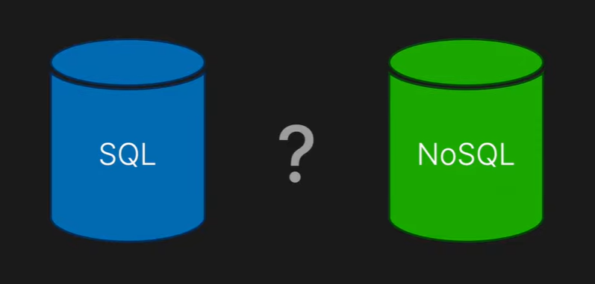
WATCH
SQL & NoSQL Databases
Watch video and answer questions
Q1 – What is a SQL database, a NoSQL database ?
Q2 – Identify reasons to choose a SQL database / a NoSQL database for a given project
https://www.youtube.com/watch?v=eVApl3kzTB0

Slide 21
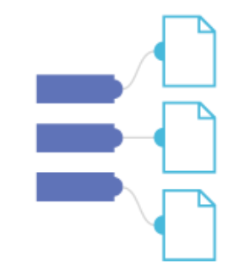
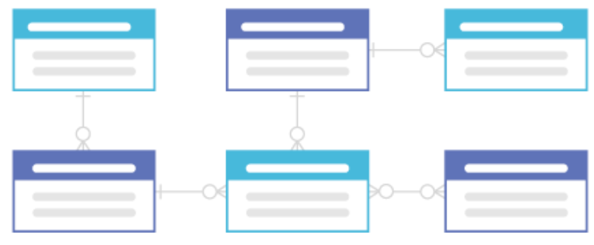

SQL & NoSQL Databases
ANSWER
SEE MORE
SQL and NoSQL represent two of the most common types of database
SQL DATABASES
NO SQL DATABASES
SQL databases use
structured tables with fixed schemas
NoSQL databases store data in flexible formats like documents or key-value pair
Ensures data stays correct and safe
Make sure all changes happen fully, don’t get mixed up with others
Highly flexible and scalable for handling large volumes of data.

Slide 22

Let’s review MySQL queries
QUIZ
4 questions
Count your points !

Slide 23
QUIZ
Q1
What is the query for this request?
Get the names of teachers who taught JavaScript.
Course
Teacher
id PK
title
teacher_id FK
id PK
name
*
1
SELECT name
FROM Teacher
WHERE title = 'Javascript';
SELECT name
FROM Course
WHERE title = 'Javascript';
A
C
SELECT Teacher.name
FROM Teacher
JOIN Course ON Teacher.id = Course.teacher_id
WHERE Course.title = 'Javascript';
SELECT name FROM Teacher
WHERE Course.title = 'Javascript';
B
D

Slide 24
ANSWER
What is the query for this request?
Get the names of teachers who taught JavaScript.
Course
Teacher
id PK
title
teacher_id FK
id PK
name
*
1
SELECT name
FROM Teacher
WHERE title = 'Javascript';
SELECT name
FROM Course
WHERE title = 'Javascript';
A
C
SELECT Teacher.name
FROM Teacher
JOIN Course ON Teacher.id = Course.teacher_id
WHERE Course.title = 'Javascript';
SELECT name FROM Teacher
WHERE Course.title = 'Javascript';
B
D

Slide 25
QUIZ
Q2
What is the query for this request?
Get the names of students enrolled in the Data Structures course.
Student
Enrollment
Course
id PK
name
1
*
student_id FK
course_id FK
*
1
id PK
title
SELECT Student.name
FROM Student
JOIN Enrollment ON Student.id = Enrollment.student_id
JOIN Course ON Course.id = Enrollment.course_id
WHERE Course.title = 'Data Structure
SELECT name FROM Student
JOIN Course ON Student.id = Course.id
WHERE title = 'Data Structures';
A
C
SELECT name FROM Student
JOIN Enrollment ON Student.id = Enrollment.student_id
WHERE course_id = 'Data Structures';
B
D
SELECT name
FROM Enrollment
WHERE title = 'Data Structur

Slide 26
ANSWER
What is the query for this request?
Get the names of students enrolled in the Data Structures course.
Student
Enrollment
Course
id PK
name
1
*
student_id FK
course_id FK
*
1
id PK
title
SELECT Student.name
FROM Student
JOIN Enrollment ON Student.id = Enrollment.student_id
JOIN Course ON Course.id = Enrollment.course_id
WHERE Course.title = 'Data Structure
SELECT name FROM Student
JOIN Course ON Student.id = Course.id
WHERE title = 'Data Structures';
A
C
SELECT name FROM Student
JOIN Enrollment ON Student.id = Enrollment.student_id
WHERE course_id = 'Data Structures';
B
D
SELECT name
FROM Enrollment
WHERE title = 'Data Structur

Slide 27
QUIZ
Q3
What is the query for this request?
Get the average rating for each course title.
Course
Ratting
id PK
title
id PK
course_id FK
start
*
1
SELECT title, AVG(stars)
FROM Rating
GROUP BY title;
SELECT title, AVG(stars)
FROM Course
GROUP BY title;
A
C
SELECT Course.title, AVG(Rating.stars)
FROM Course
JOIN Rating ON Course.id = Rating.course_id
GROUP BY Course.title;
B
D
SELECT Course.title, Rating.stars
FROM Course
JOIN Rating ON Course.id = Rating.course_id;

Slide 28
ANSWER
What is the query for this request?
Get the average rating for each course title.
Course
Ratting
id PK
title
id PK
course_id FK
start
*
1
SELECT title, AVG(stars)
FROM Rating
GROUP BY title;
SELECT title, AVG(stars)
FROM Course
GROUP BY title;
A
C
SELECT Course.title, AVG(Rating.stars)
FROM Course
JOIN Rating ON Course.id = Rating.course_id
GROUP BY Course.title;
B
D
SELECT Course.title, Rating.stars
FROM Course
JOIN Rating ON Course.id = Rating.course_id;

Slide 29
QUIZ
Q3
What is the query for this request?
List the names of students who scored above 90 in any course
Student
Grade
Course
id PK
name
1
*
student_id FK
course_id FK
score
*
1
id PK
title
SELECT name
FROM Student
JOIN Course ON Student.id = Course.id
WHERE score > 90;
SELECT name
FROM Grade
WHERE score > 90;
A
C
B
SELECT Student.name
FROM Student
JOIN Grade ON Student.id = Grade.student_id
WHERE Grade.score > 90;
D
SELECT name
FROM Student
WHERE score > 90;

Slide 30
ANSWER
What is the query for this request?
List the names of students who scored above 90 in any course
Student
Grade
Course
id PK
name
1
*
student_id FK
course_id FK
score
*
1
id PK
title
SELECT name
FROM Student
JOIN Course ON Student.id = Course.id
WHERE score > 90;
SELECT name
FROM Grade
WHERE score > 90;
A
C
B
SELECT Student.name
FROM Student
JOIN Grade ON Student.id = Grade.student_id
WHERE Grade.score > 90;
D
SELECT name
FROM Student
WHERE score > 90;

Slide 31
Let’s connect!
Let s connect Node.js Express to MySQL Database in 7 steps
NODE BACK END
Router
Controller
Repository
Requests
MySQL
Database

Slide 32
TUTORIAL
Install Required Packages
1. REQUIRED PACKAGES
2. FOLDER STRUCTURE
3. ENVIRONMENT VARIABLES (.ENV)
4. DATABASE CONNECTION MODULE
5. REPOSITORY LAYER
CONTROLLER LAYER
ROUTES LAYER
npm init -y
npm install express mysql2 dotenv
Let Node.js connect to and query MySQL
Supports promises (async/await)
Loads variables from .env into process.env
Keeps DB credentials and configs out of your code

Slide 33
TUTORIAL
Create Folder Structure
project/
├── controllers/
│ └── userController.js
├── repositories/
│ └── userRepository.js
├── routes/
│ └── userRoutes.js
├── db/
│ └── database.js
├── .env
├── server.js
1. REQUIRED PACKAGES
2. FOLDER STRUCTURE
3. ENVIRONMENT VARIABLES (.ENV)
4. DATABASE CONNECTION MODULE
5. REPOSITORY LAYER
CONTROLLER LAYER
ROUTES LAYER
Handles business logic
Handles database queries
Create a reusable database connection pool
Stores configuration values
DB credentials …

Slide 34

TUTORIAL
Configure Environment Variable
1. REQUIRED PACKAGES
2. FOLDER STRUCTURE
3. ENVIRONMENT VARIABLES (.ENV)
4. DATABASE CONNECTION MODULE
5. REPOSITORY LAYER
CONTROLLER LAYER
ROUTES LAYER
DB_HOST=localhost
DB_USER=root
DB_PASSWORD=yourpassword
DB_NAME=mydatabase
DB_PORT=3306
Provide MySQL
Admin infos
Don't share your password and admin info !
= Don’t commit .env to Git — add .env to .gitignore.

Slide 35
TUTORIAL
Create Database Connection Module
const mysql = require('mysql2');
require('dotenv').config();
const pool = mysql.createPool({
host: process.env.DB_HOST,
user: process.env.DB_USER,
password: process.env.DB_PASSWORD,
database: process.env.DB_NAME,
port: process.env.DB_PORT,
waitForConnections: true,
connectionLimit: 10,
queueLimit: 0,
});
module.exports = pool.promise(); // Promise-based for `async/await`
1. REQUIRED PACKAGES
2. FOLDER STRUCTURE
3. ENVIRONMENT VARIABLES (.ENV)
4. DATABASE CONNECTION MODULE
5. REPOSITORY LAYER
CONTROLLER LAYER
ROUTES LAYER
Read the .env data
creates a connection pool instead of a single database connection.
Access to .env data

Slide 36
EXPLAIN
MySQL pool with Promises
The pool of MySQL connections supports async/await for efficient database queries.
const mysql = require('mysql2/promise');
const pool = mysql.createPool({ ... });
async function getUsers() {
try {
const [rows] = await pool.query('SELECT * FROM users’);
...
} catch (err) {
...
}
}
If success
If failed
Query answer
Query expression

Slide 37
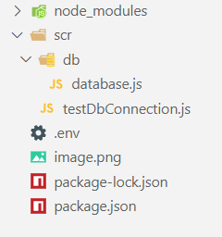
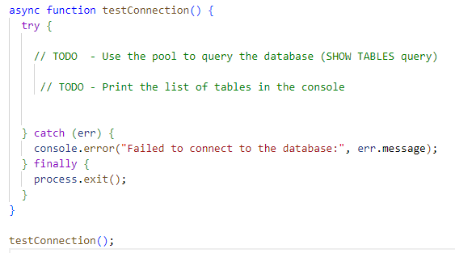
ACTIVITY
Test the connection
We provide a start code with a database.js
Complete the testDbConnection to display the list of tables of your database
You need to have a MySQL server running
The server need to have a few tables created

Slide 38
TUTORIAL
Create Repository Layer
1. REQUIRED PACKAGES
2. FOLDER STRUCTURE
3. ENVIRONMENT VARIABLES (.ENV)
4. DATABASE CONNECTION MODULE
5. REPOSITORY LAYER
CONTROLLER LAYER
ROUTES LAYER
async function getUserById(id) {
const userId = parseInt(id, 10);
if (isNaN(userId)) {
throw new Error('Invalid user ID: must be an integer');
}
const [rows] = await pool.query('SELECT * FROM users WHERE id = ?', [id]);
return rows[0];
}
Validation
Of the parameters
Database query

Slide 39
TUTORIAL
Create Controller Layer
1. REQUIRED PACKAGES
2. FOLDER STRUCTURE
3. ENVIRONMENT VARIABLES (.ENV)
4. DATABASE CONNECTION MODULE
5. REPOSITORY LAYER
CONTROLLER LAYER
ROUTES LAYER
const userRepo = require('../repositories/userRepository');
async function getUsers(req, res) {
try {
const users = await userRepo.getAllUsers();
res.json(users);
} catch (err) {
res.status(500).json({ error: 'Failed to fetch users' });
}
}
The controller handles the logic and prepare the JSON return

Slide 40
TUTORIAL
Create The Route Layer
1. REQUIRED PACKAGES
2. FOLDER STRUCTURE
3. ENVIRONMENT VARIABLES (.ENV)
4. DATABASE CONNECTION MODULE
5. REPOSITORY LAYER
CONTROLLER LAYER
ROUTES LAYER
const express = require('express');
const router = express.Router();
const userController = require('../controllers/userController');
router.get('/', userController.getUsers);
router.get('/:id', userController.getUser);
module.exports = router;

Slide 41
WHAT WE HAVE LEARNT
JS Async syntax … Get ready for for database interactions !
Apply destructuring with arrays and objects
Understand Promises and handle .then() / .catch()
Write clean async code using async / await
Understand the need for databases
Differentiate between SQL and NoSQL databases
Review key MySQL queries for data manipulation
Connect a Node to MySQL database
Organize code using clean architecture principles for maintainability

Slide 42
HOMEWORK
Research and Code
What is SQL injection ?
How to prevent it and where ?
In regard to our clean architecture:
Router > Controller > Repository > DB

Slide 43


TO GO FURTHER
UNDERSTAND SQL / NO SQL DATABASES
https://www.scylladb.com/learn/nosql/nosql-vs-sql/
REVIEW MY SQL SYNTAX
https://www.tutorialspoint.com/mysql/index.htm
START WITH NODE JS + MYSQL
https://www.youtube.com/watch?v=Hej48pi_lOc
https://blog.logrocket.com/build-rest-api-node-express-mysql
https://www.w3schools.com/nodejs/nodejs_mysql.asp
JS SYNTAX
https://www.w3schools.com/js/js_promise.asp

